Slide 1
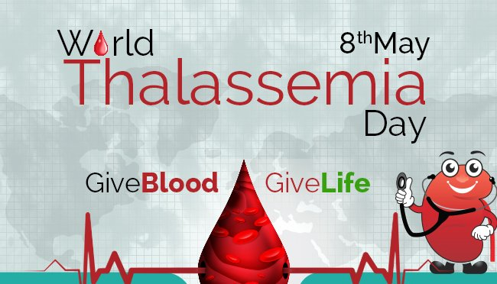
Overview of Thalassemia
https://www.iaspaper.net/world-thalassemia-day/

Slide 2
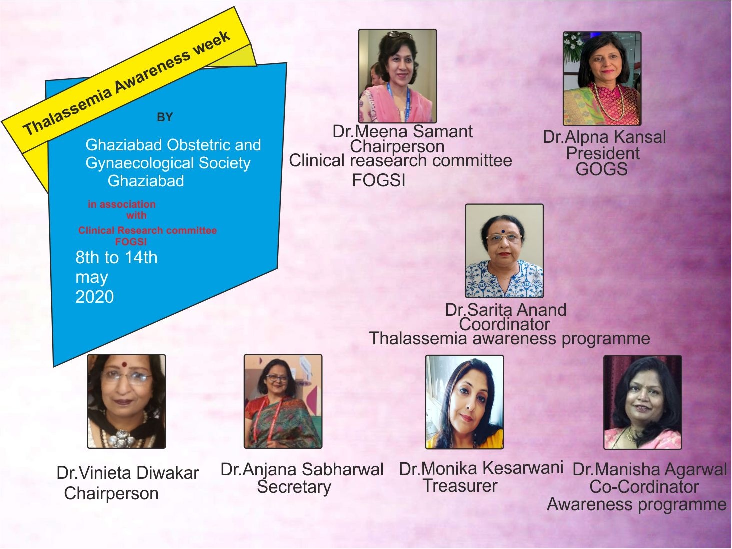

Slide 3
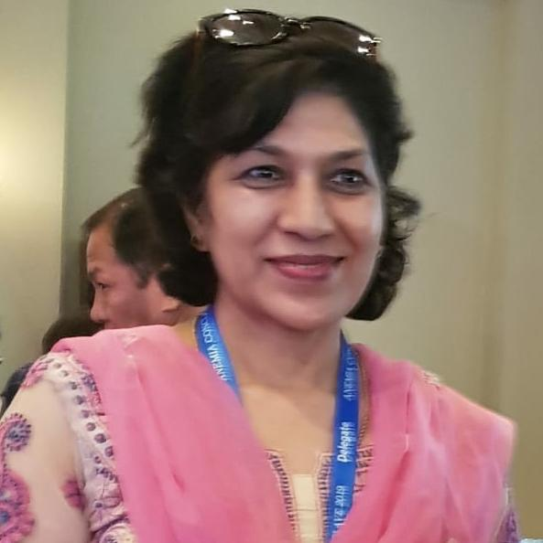
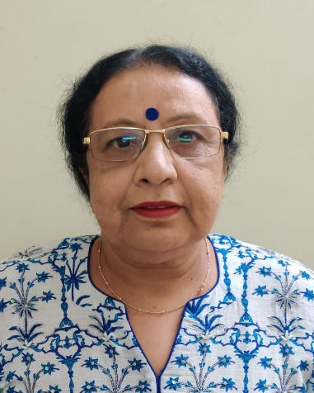
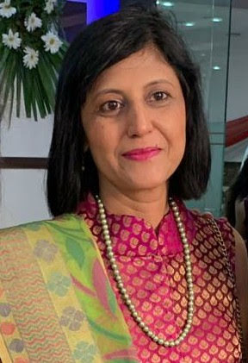
This year’s (2020)theme is “Thalassemia Free India”
Chairperson
Clinical research committee
FOGSI
Dr.Sarita Anand
Senior GOGSian
Coordinator for
Awareness on Thalassemia
President
Ghaziabad Obstetric & Gynaecological Society
Have come together to bring you this awareness programme on Thalassemia

Slide 4

THALASSEMIA
FREE
INDIA

Slide 5
World Thalassemia Day is celebrated every year on May 8th to commemorate Thalassemia victims and to encourage those who struggle to live with disease

Slide 6
Thalassemia
Derived from Greek word “thalasa”meaning ocean as patients were first identified along the coast of Mediterranean Sea
By leading scientists Lee & Cooper in 1925.
It is an inherited genetic blood disorder where patients cannot produce adequate healthy hemoglobin resulting in need for continuous blood transfusion.
The Blood which saves their lives,creates an iron overload in the system.
The excess iron must be chelated out of their system.
The process is both painful and costly.

Slide 7
Contd:
Mild thalassemia may not need treatment.
Signs and symptoms depend on type & severity of disease which are fatigue,weakness,pale skin,facial deformities,slow growth,abdominal swelling & dark urine
You can take steps to cope with fatigue, such as choosing a healthy diet and exercising regularly.​
More severe forms may require regular blood transfusions.

Slide 8

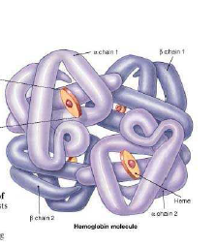
Hemoglobin structure
Hb : highly specialised protein molecule in RBCs
Two components :Heme 4 & 4 Globin chains
Two identical ᾰ chains & two ẞ chains
Heme is an iron porphyrin compound
Each chain contains heme in so called heme pocket
Some 30 abnormal types of
hemoglobin have been reported

Slide 9
TYPES OF HEMOGLOBIN
Hb A :2ᾰ &2 ẞ chains
97% of Adult hemoglobin
After birth Hb F is replaced by Hb A by six months of age
Hb F:2ᾰ & 2 ¥ chains
At birth newborn has 70-90% of Hb F
By one year of age it remains <2%
Hb A2: 2ᾰ & 2 ẟ chains
Normal adult has 1.5 to <3.5 %
High % of Hb A2 indicates a thalassemia trait

Slide 10
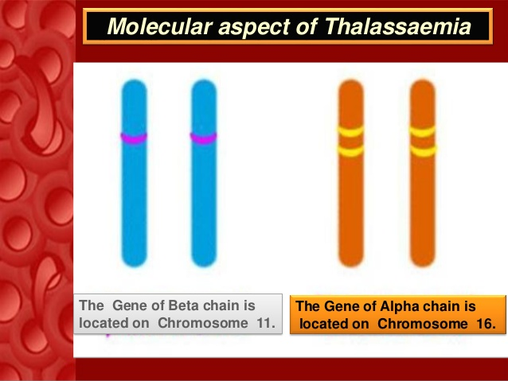

Slide 11
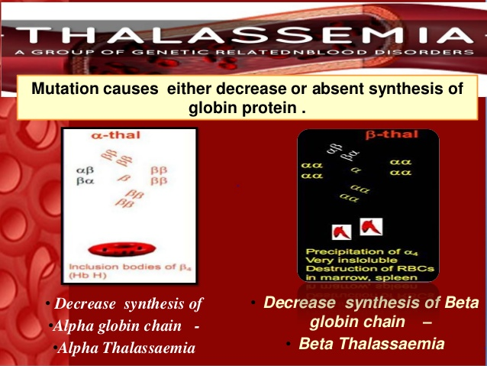
More than 200 mutations are known to cause Thalassemia all over the world

Slide 12
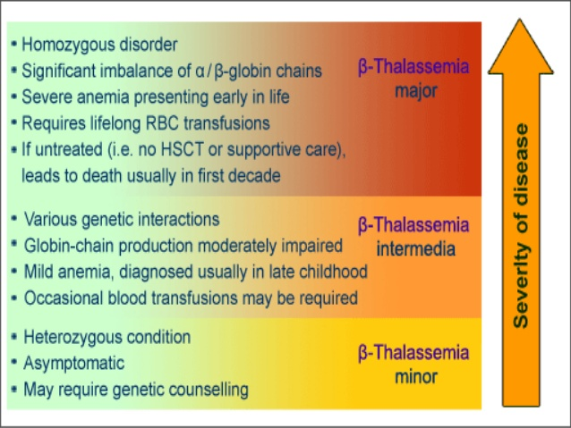

Slide 13
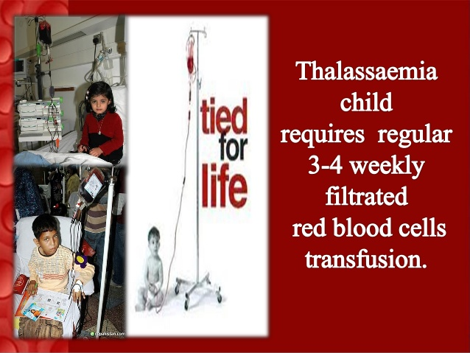

Slide 14
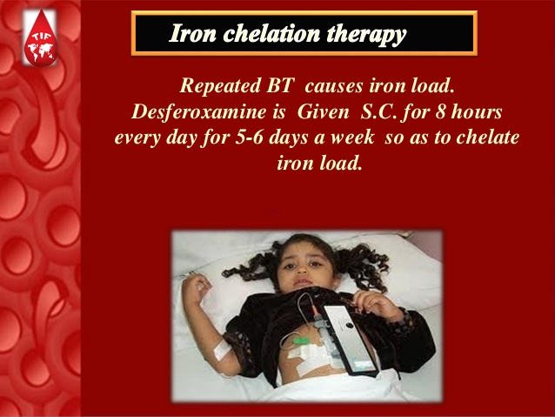

Slide 15
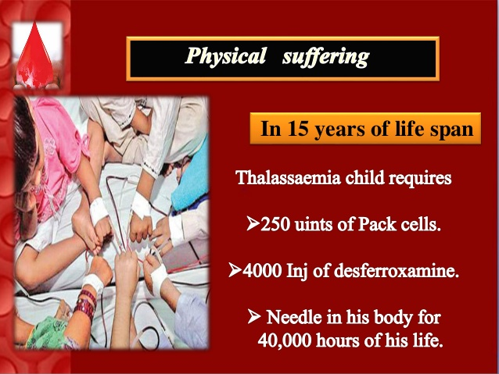

Slide 16
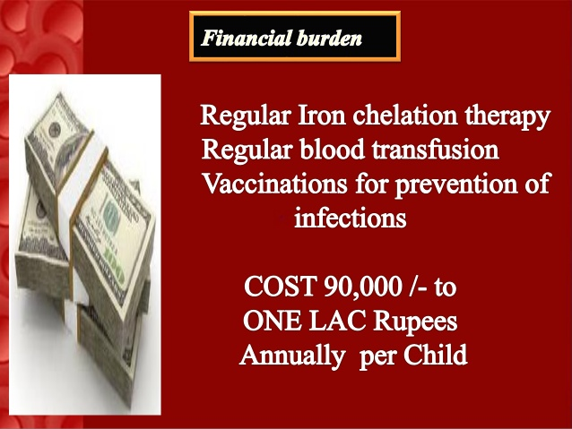

Slide 17
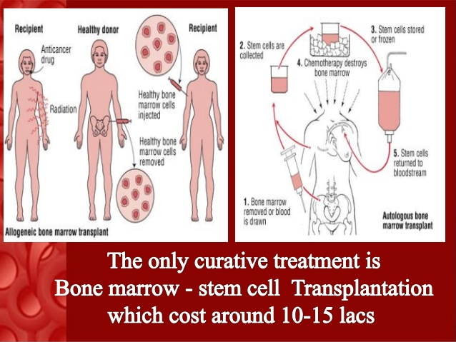

Slide 18
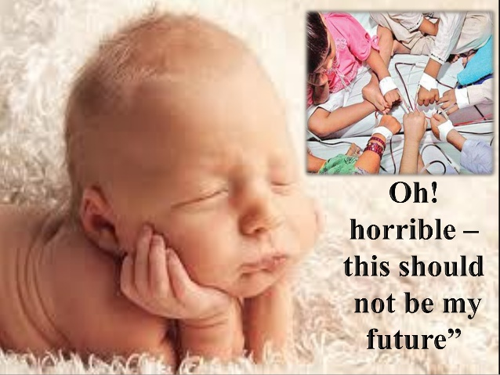

Slide 19
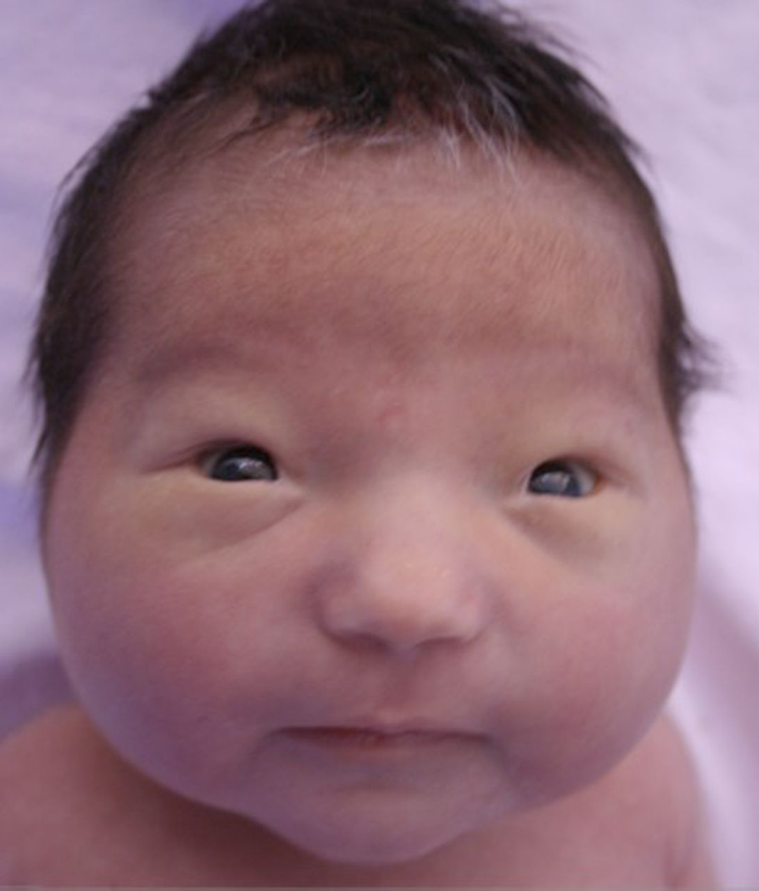
HOW IS A THALASSEMIC BABY BORN

Slide 20
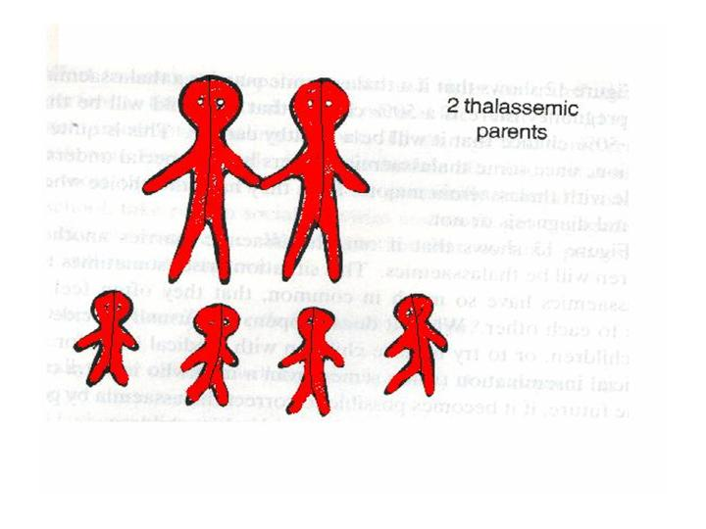
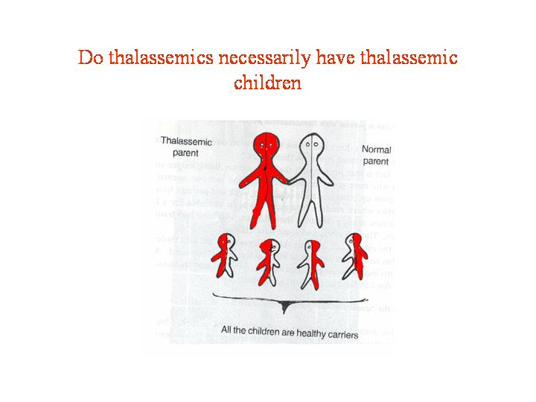
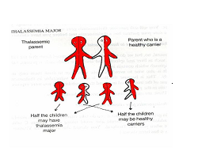
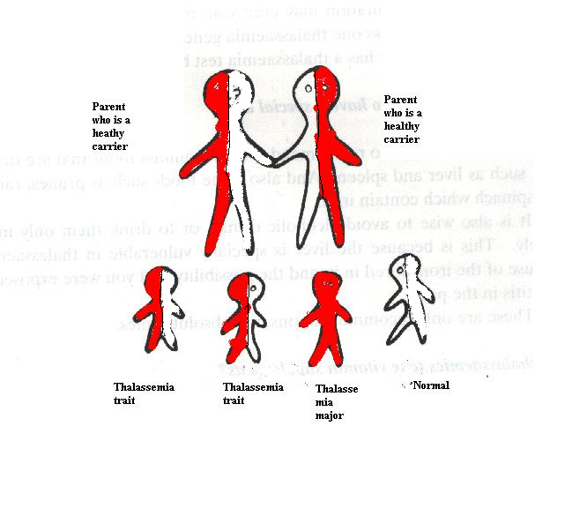

Slide 21
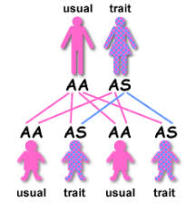

Slide 22
Magnitude of the problem
Worldwide 250 million people are carriers of ẞ -thalassemia i.e. 1.5⁒of total world population
Approximately 15 million people are expected to suffer from “thalassemia major”
Every year one lakh children are born with thalassemia major
Every hour 1 thalassemia major child is born & approx. 10,000 new thalassemia patients are born in India every year.
In India Thalassemic trait accounts for 4%,soon can go upto17%
Means 1 out of every 8 to 10 persons in India is a victim of Thalassemia.
If ignorance about Thalassemia is not eradicated fast,there is sure to be an epidemic

Slide 23
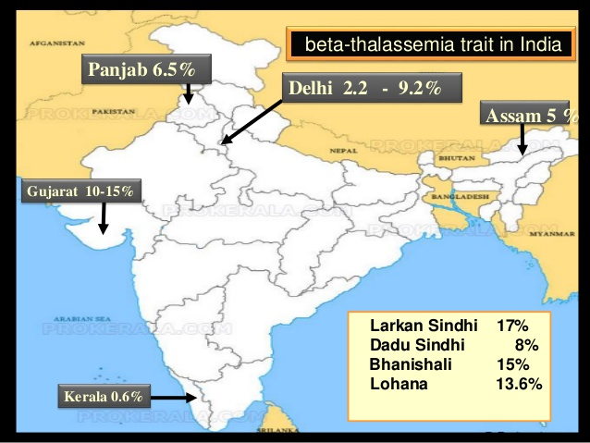

Slide 24
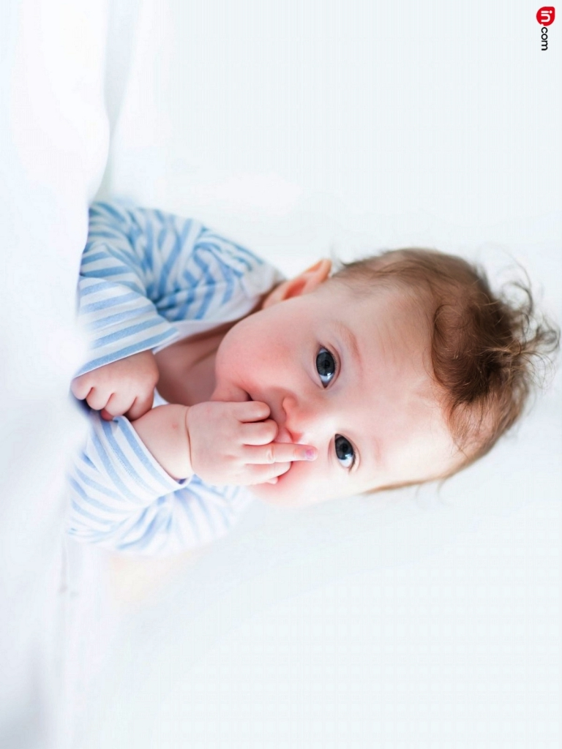
AIMS & OBJECTIVES
TO DIAGNOSE
Thalassemia carrier status before
pregnancy/at conception
TO REDUCE
Incidence of Thalassemia by genetic
counselling
TO PREVENT
Birth of a thalassemia Major baby by
prenatal diagnosis
Centres for prevention ,diagnosis and management
TO SET UP

Slide 25
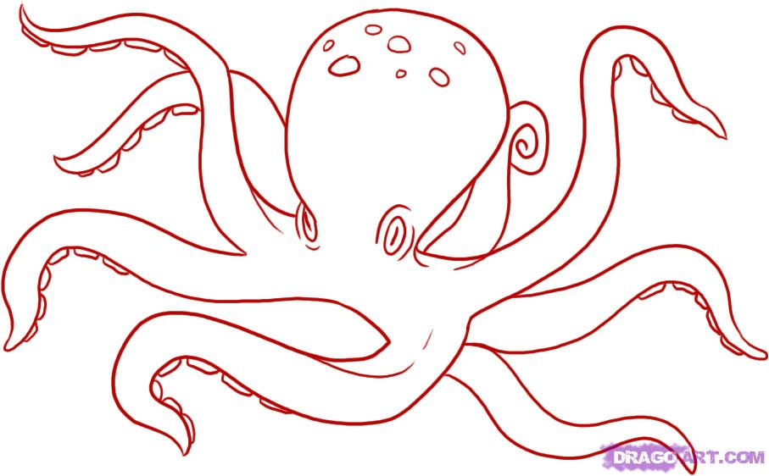
Challenges for thalassemia free India
Lack Of Funds
Lack of Screening
Lack Of Education
Social Factors
Lack Of National Policy
Lack of Fetal Medicine centres
Lack Of Genetic Centres
Lack Of Experts

Slide 26
Challenges contd:
Carrier should not marry a carrier,if unavoidable due to cultural and social reasons or diagnosed to be carriers after marriage then prenatal screening should be offered.
For couples who already have a affected baby are adviced PGD,it also avoids psychological stress associated with termination of pregnancy.
Lack of well equipped labs and genetic centres

Slide 27
Challenges contd:
Illiteracy is a big challenge for prevention of Thalassemia.
Lack of premarital screening(detection of carrier state seems to be a “stigma”to their life)
Lack of preconception counselling(due to lack of knowledge,late antenatal bookings and funds& fear factor for screening methods

Slide 28
IDENTIFY THE CARRIER
HOW

Slide 29
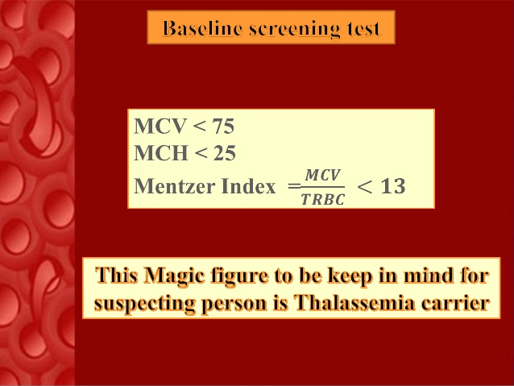

Slide 30
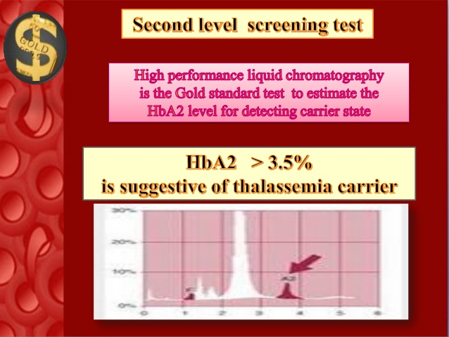

Slide 31
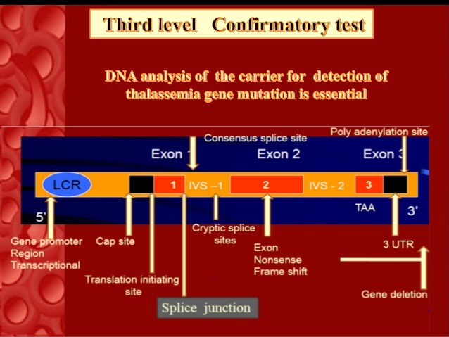

Slide 32
CARRIER SHOULD NOT MARRY A CARRIER
MEDICAL KUNDLI MILAN
INSTEAD
OF
JANAM KUNDLI MILAN

Slide 33
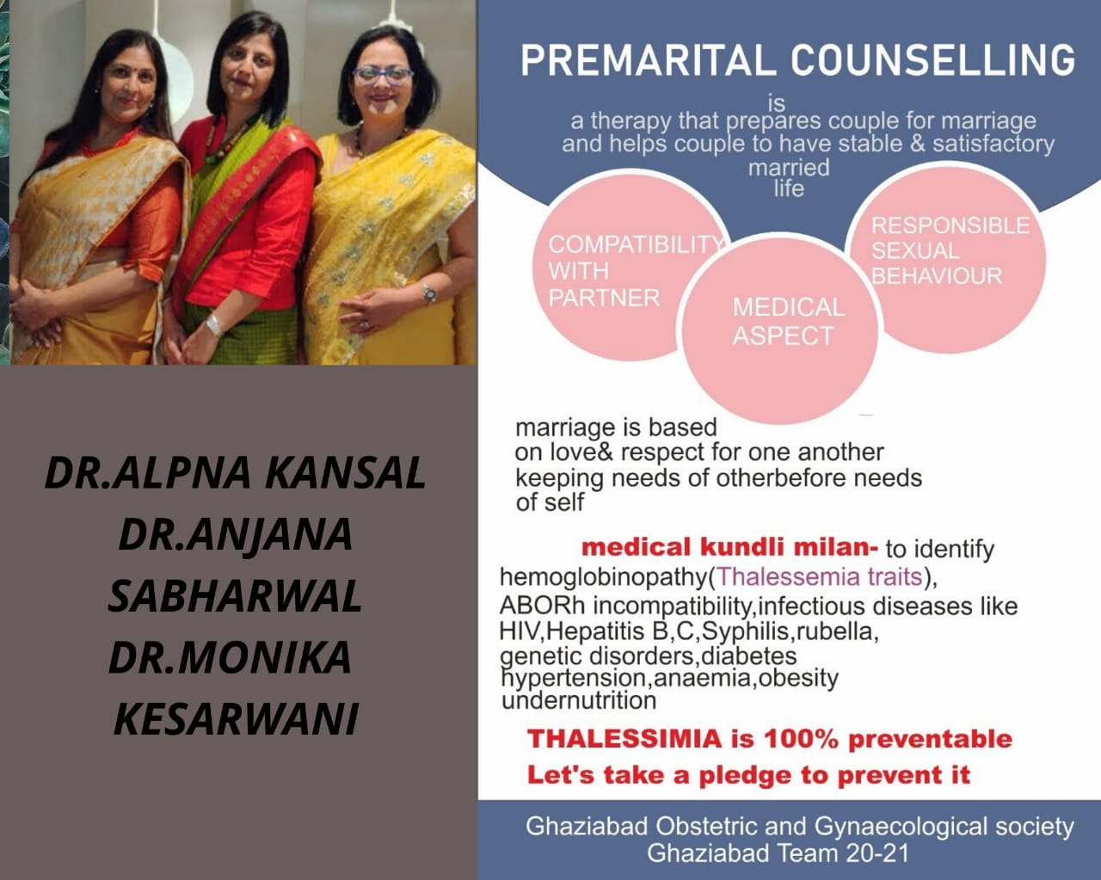

Slide 34
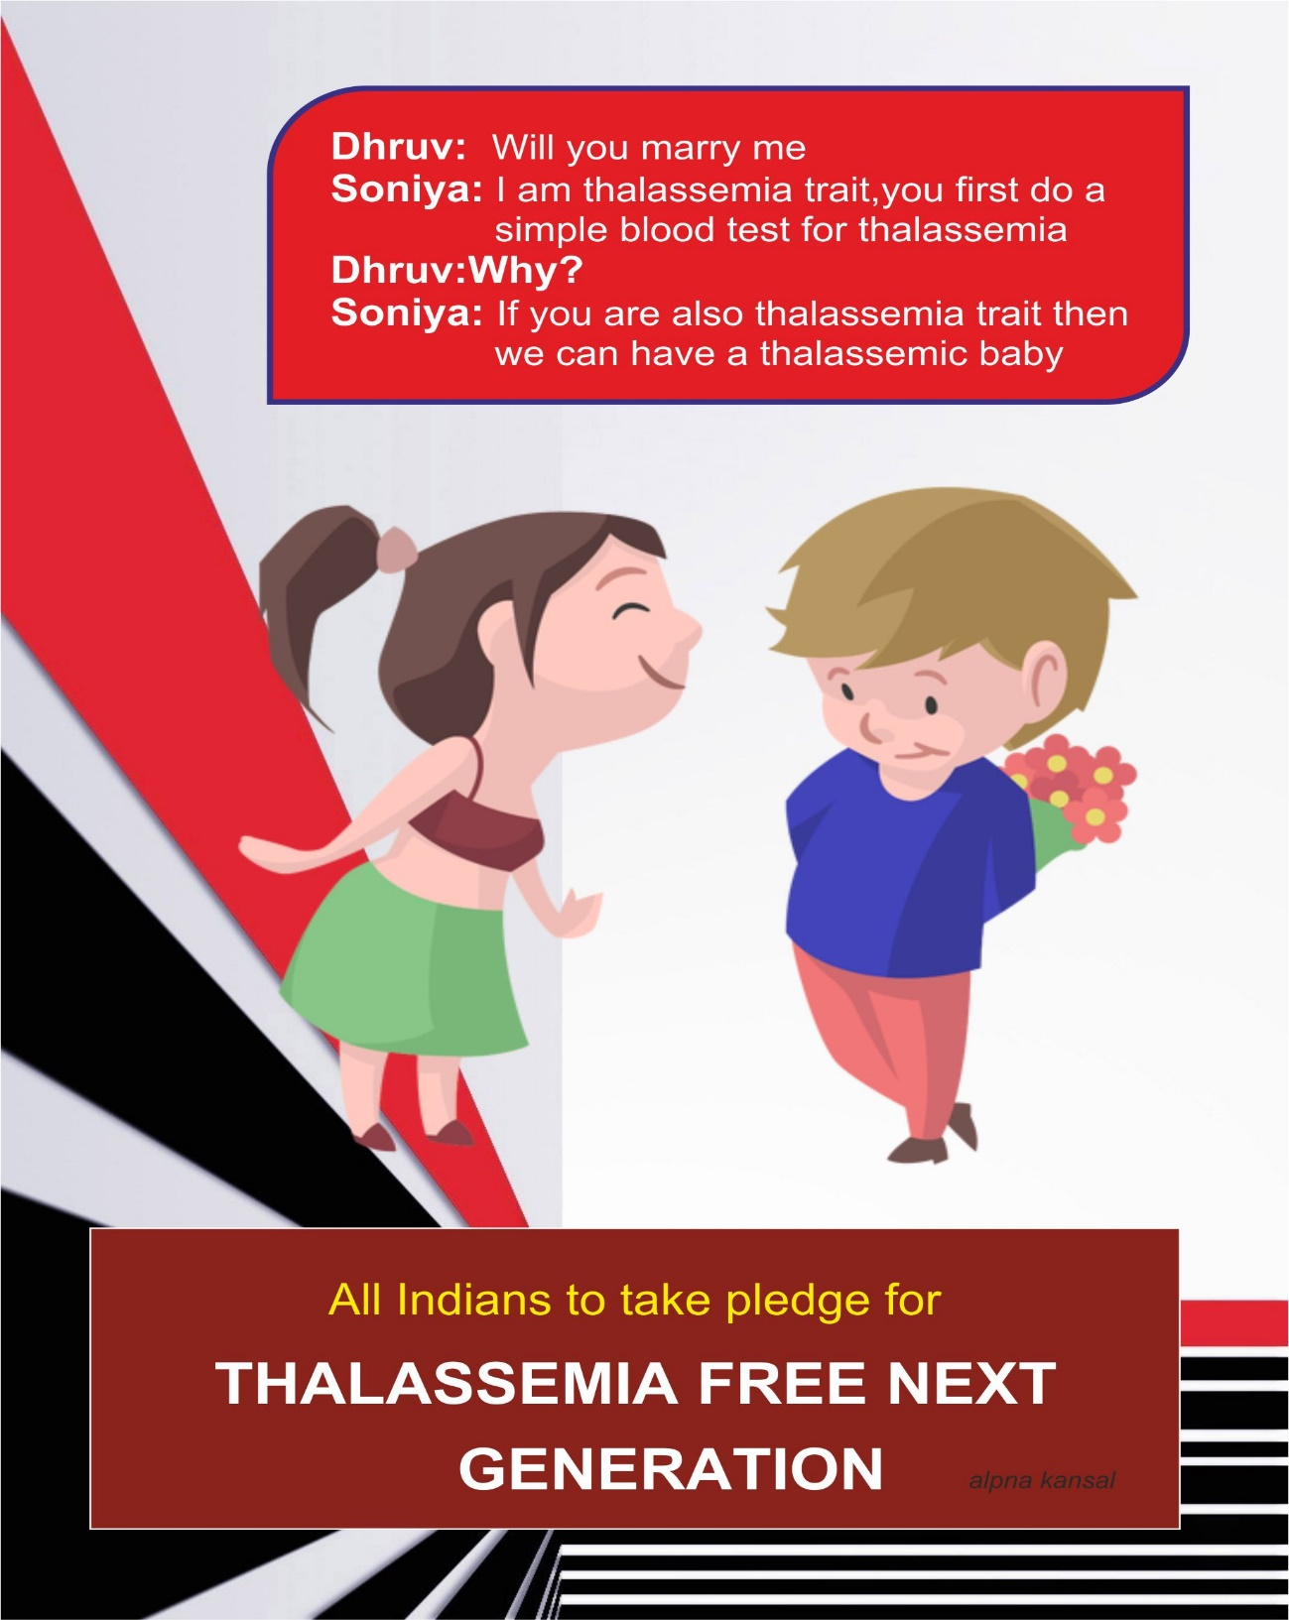
As responsible citizens we should not be ignorant and should be able to take decision whether we wish to feed our child with milk or blood

Slide 35
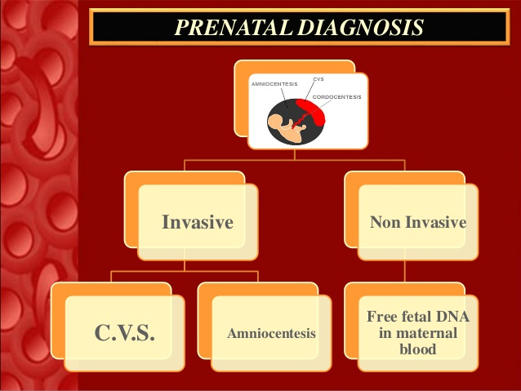

Slide 36
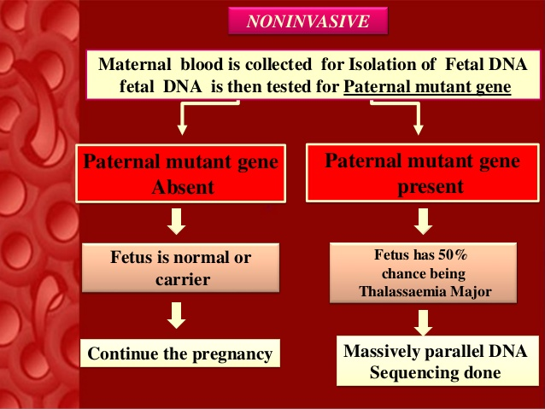

Slide 37
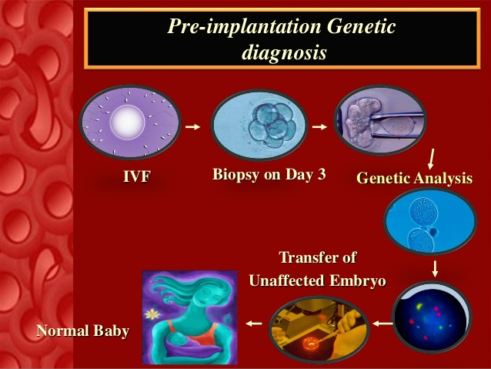

Slide 38


Slide 39

Preventing the birth of a “Thalassemia” child is the only answer to this worldwide problem

Slide 40

Obstetrician
Genetist
Social worker
Ultrasonologist
Genetic
counsellor
Paediatrician
Pathologist

Slide 41
Awareness programmes for development of knowledge and attitude of society
Doctors ,paramedical staff,counsellors should give information regarding premarital counselling ,prenatal diagnosis by pamphlets,videos,slide shows,social media,conferences,
seminars etc.

Slide 42
Role Of Obstetricians
Educate families to test their kids for carrier status , if we find women to be carriers when they come for delivery
Premarital counselling
Preconception counselling
Prenatal testing
PGD when indicated
Social awareness programmes

Slide 43
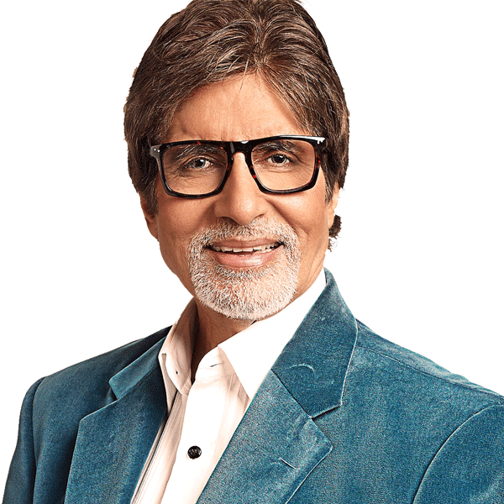
Thalassemia trait is not a disease
Amitabh Bachchan is a thalassemia carrier
married
to
Jaya bachan
non carrier
And children are
non carriers

Slide 44


Slide 45

Lets take pledge to screen ourselves for thalassemia
Lets take pledge to donate blood

Slide 46


